Slide 1
COMP9414 Tutorial
Week 8

Slide 2

News
Assignment 1 submissions have closed
Marks have been released
Check them and contact your tutor/lecturer if you have concerns
Plagiarism checking is currently happening
Hope you renamed those variables
Assignment 2 has been released
Due in week 9
Should have everything needed to complete it now

Slide 3
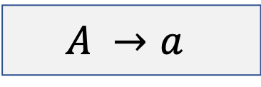
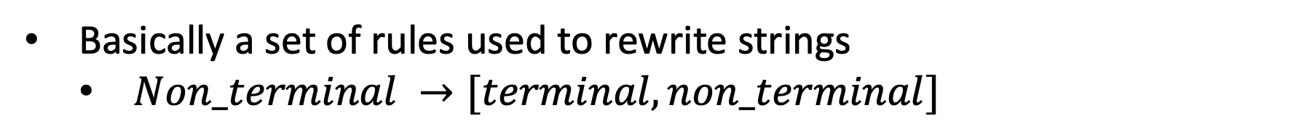
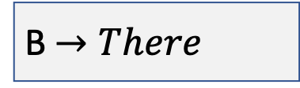
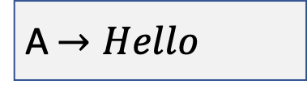
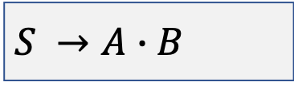
Context-free Grammar
Basically a set of rules used to rewrite strings
$Non_terminal →[terminal, non_terminal]$
$$A →a$$
Example
$$S →A∙B$$
Hello There
A$→Hello$
Hello John
B$→There$
Good bye

Slide 4
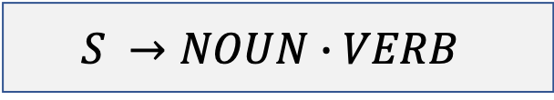
Lexicon
Constituent elements of a particular language
Basically the literals
Grammar
$$S →NOUN∙VERB$$
$$NOUN: car, dog, train, zebra$$
$$VERB: driving, barking, jumping, walking$$

Slide 5
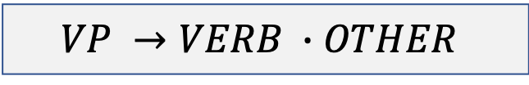
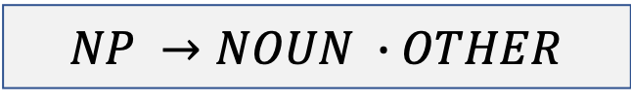
English Language Grammar
Noun Phrase
$$NP →NOUN ∙OTHER$$
A thing such as a cat or a dog.
Can generally be singular or quantified.
Verb Phrase
$$VP →VERB ∙OTHER$$
A doing word such as running or climbing.
Typically applied to a noun.

Slide 6


English Language Grammar
Prepositional Phrase
$$PP →PROP ∙OTHER$$
A modifier to a clause.
In time
Along the highway
By singing
Without excessive worrying
Adjective Phrase
$$ADJP →ADJ ∙OTHER$$
Describe or modify a noun.
Old dog
Sleepy doctor
Burnt trees
Hungry panda

Slide 7

English Language Grammar
Adverb Phrase
$$ADVP →ADV ∙OTHER$$
Describe or modify a verb or adjective.
He sings loudly
The race finished too quickly
Ben is very tall
I worked yesterday

Slide 8
Question 1 – Bottom-up Parsing
Parse each token in the sentence sequentially:
Convert the literal into its constituent
Add the constituent to the chart
Determine if the constituent is the first token in any grammar rule
Add that grammar rule as an active arc
Check to see if any subsequence of tokens so far corresponds to a rule in the active arc
Add the rule to the chart if so

Slide 9
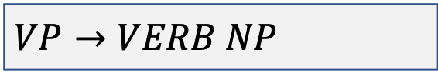
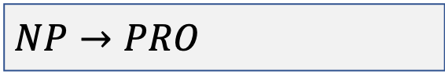
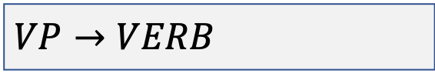
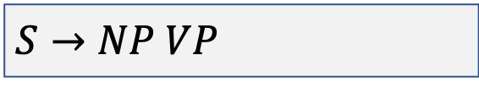
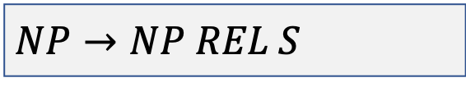
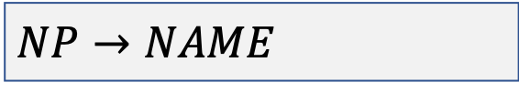
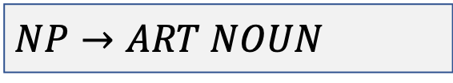
Question 1
This is the house that jack built
Grammar
Lexion
$$S→NP VP$$
This: PRO
$$NP→PRO$$
is: VERB
$$NP→ART NOUN$$
the: ART
$$NP→NAME$$
house: NOUN
$$NP→NP REL S$$
that: PRO, REL
$$VP→VERB$$
Jack: NAME
$$VP→VERB NP$$
built: VERB

Slide 10
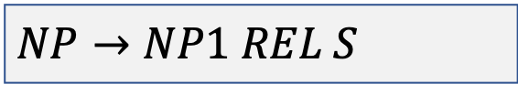
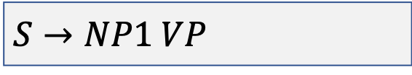
Question 1
This is the house that jack built
These are the grammar that our current rules start with. For example. NP1 is first in the rule S, which is the same for the rule NP.
Active Arcs
$$S→NP1 VP$$
$$NP→NP1 REL S$$
NP1 (Rule 2)
0
This
1
PRO (Lex 1)

Slide 11
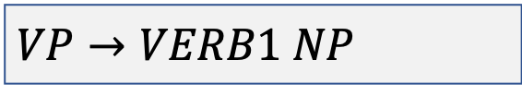
Question 1
This is the house that jack built
Active Arcs
$$S→NP1 VP$$
$$NP→NP1 REL S$$
NP1 (Rule 2)
VP1 (Rule 6)
$$VP→VERB1 NP$$
0
This
1
is
2
PRO (Lex 1)
VERB1 (Lex 2)

Slide 12
Question 1
This is the house that jack built
Active Arcs
$$S→NP1 VP$$
S1 (Rule 1)
$$NP→NP1 REL S$$
NP1 (Rule 2)
VP1 (Rule 6)
$$VP→VERB1 NP$$
0
This
1
is
2
PRO (Lex 1)
VERB1 (Lex 2)

Slide 13
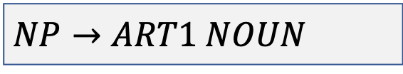
Question 1
This is the house that jack built
Active Arcs
$$S→NP1 VP$$
S1 (Rule 1)
$$NP→NP1 REL S$$
NP1 (Rule 2)
VP1 (Rule 6)
$$VP→VERB1 NP$$
$$NP→ART1 NOUN$$
0
This
1
is
2
the
3
PRO (Lex 1)
VERB1 (Lex 2)
ART1 (Lex 3)

Slide 14
Question 1
This is the house that jack built
S1 (Rule 1)
NP1 (Rule 2)
VP1 (Rule 6)
0
This
1
is
2
the
3
house
4
PRO (Lex 1)
VERB1 (Lex 2)
ART1 (Lex 3)
NOUN1 (Lex 4)

Slide 15

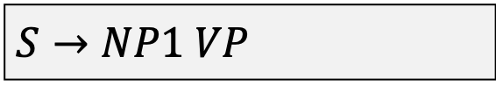
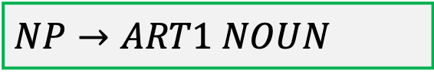
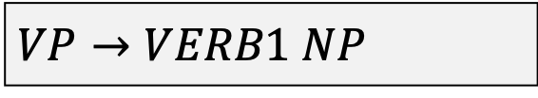
Question 1
This is the house that jack built
Active Arcs
$$S→NP1 VP$$
$$NP→NP1 REL S$$
$$VP→VERB1 NP$$
$$NP→ART1 NOUN$$

Slide 16
Question 1
This is the house that jack built
S1 (Rule 1)
NP1 (Rule 2)
VP1 (Rule 6)
NP2 (Rule 3)
0
This
1
is
2
the
3
house
4
PRO (Lex 1)
VERB1 (Lex 2)
ART1 (Lex 3)
NOUN1 (Lex 4)

Slide 17
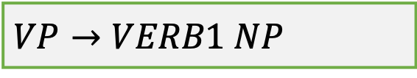
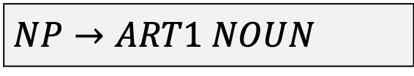
Question 1
This is the house that jack built
Active Arcs
$$S→NP1 VP$$
$$NP→NP1 REL S$$
$$VP→VERB1 NP$$
$$NP→ART1 NOUN$$

Slide 18
Question 1
This is the house that jack built
S1 (Rule 1)
VP2 (Rule 7)
VERB1 NP2
NP1 (Rule 2)
VP1 (Rule 6)
NP2 (Rule 3)
0
This
1
is
2
the
3
house
4
PRO (Lex 1)
VERB1 (Lex 2)
ART1 (Lex 3)
NOUN1 (Lex 4)

Slide 19
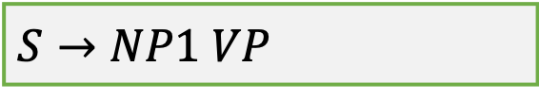
Question 1
This is the house that jack built
Active Arcs
$$S→NP1 VP$$
$$NP→NP1 REL S$$
$$VP→VERB1 NP$$
$$NP→ART1 NOUN$$

Slide 20
Question 1
This is the house that jack built
S2 (Rule 1)
NP1 VP2
S1 (Rule 1)
VP2 (Rule 7)
VERB1 NP2
NP1 (Rule 2)
VP1 (Rule 6)
NP2 (Rule 3)
0
This
1
is
2
the
3
house
4
PRO (Lex 1)
VERB1 (Lex 2)
ART1 (Lex 3)
NOUN1 (Lex 4)

Slide 21
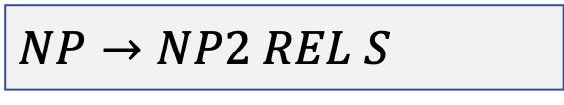
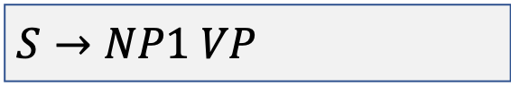
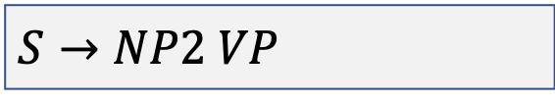

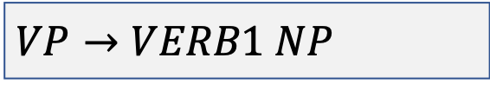
Question 1
This is the house that jack built
Active Arcs
$$S→NP1 VP$$
$$NP→NP1 REL S$$
$$VP→VERB1 NP$$
$$NP→ART1 NOUN$$
$$S→NP2 VP$$
$$NP→NP2 REL S$$

Slide 22
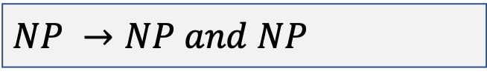
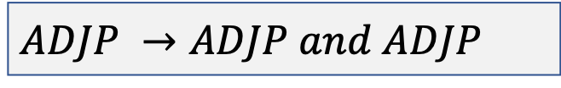
Question 2i
Phrases
Today is hot and humid
NOUN VERB ADJ and ADJ
$$ADJP →ADJP and ADJP$$
John and Mary went to the beach
NOUN and NOUN VERB PROP ADJ NOUN
$$NP →NP and NP$$

Slide 23
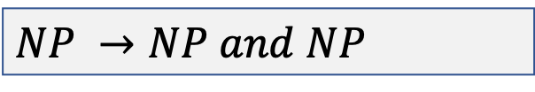
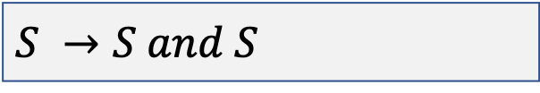
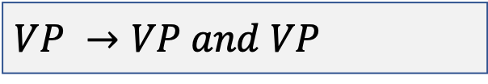
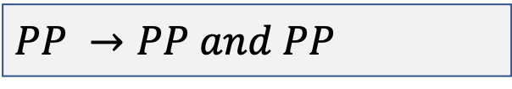
Question 2i
Phrases
John went to the park and Mary went to the beach
NOUN VERB PROP ADJ NOUN and NOUN VERB PROP ADJ NOUN
$$S →S and S$$
$$NP →NP and NP$$
$$PP →PP and PP$$
$$VP →VP and VP$$

Slide 24
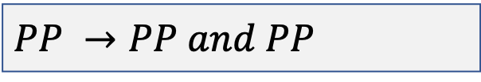
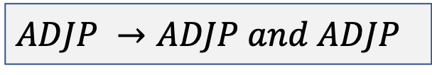
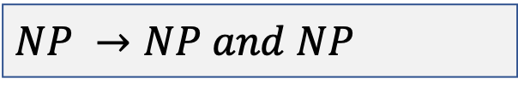
Question 2i
Phrases
John went to the park and to the beach
NOUN VERB PROP ADJ NOUN and PROP ADJ NOUN
$$PP →PP and PP$$
$$ADJP →ADJP and ADJP$$
$$NP →NP and NP$$

Slide 25
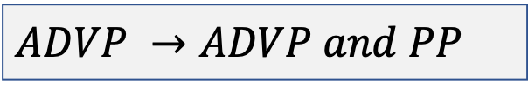
Question 2i
Phrases
John talks quickly and in a loud voice
NOUN VERB ADV and PROP a ADJ NOUN
$$ADVP →ADVP and PP$$

Slide 26
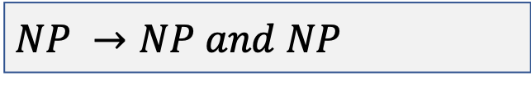
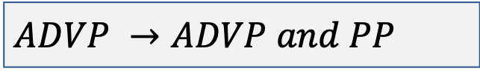
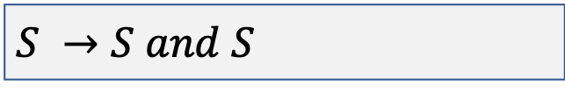
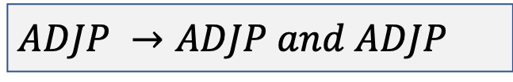
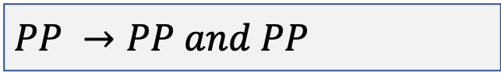

Question 2i
Grammar Rules
$$S →S and S$$
$$NP →NP and NP$$
$$VP →VP and VP$$
$$PP →PP and PP$$
$$ADJP →ADJP and ADJP$$
$$ADVP →ADVP and PP$$

Slide 27
Question 2ii – Noun/Pronoun Features
Person-view
First
Second
Third
Number
Singular
Plural
Gender
Masculine
Neuter
Feminine

Slide 28
Question 2ii – Noun/Pronoun Features
Case
Nominative
Denotes the subject of a verb.
He went bowling
NOUN VERB VERB
Accusative
Denotes the noun as an object of an action.
Good things happened to her
ADJ NOUNS VERB PREP NOUN

Slide 29
Question 2ii
Pronoun | Person | Number | Gender | Case
He | Third | Singular | Masculine | Nominative
She | Third | Singular | Feminine | Nominative
It | Third | Singular | Neuter | Neuter
Him | Third | Singular | Masculine | Accusative
Her | Third | Singular | Feminine | Accusative

Slide 30
Question 2ii
Incorrect sentences
Him and she went to the park.
John and Jack drinks coffee.
John went to the park and drink coffee.
John went to he.

Slide 31
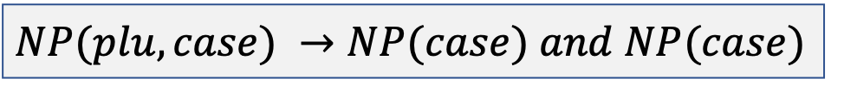
Question 2ii
Incorrect sentences
Him and she went to the park.
$$NP(plu, case) →NP(case) and NP(case)$$
John and Jack drinks coffee.
John went to the park and drink coffee.
John went to he.

Slide 32

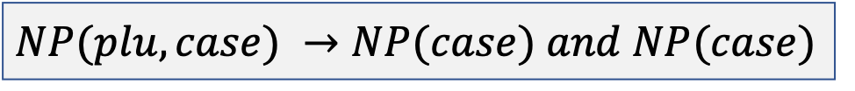
Question 2ii
Incorrect sentences
Him and she went to the park.
$$NP(plu, case) →NP(case) and NP(case)$$
John and Jack drinks coffee.
$$NP(plu, case) →NP(case) and NP(case)$$
John went to the park and drink coffee.
John went to he.

Slide 33

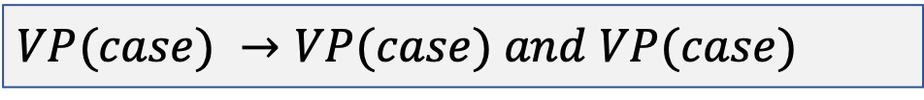
Question 2ii
Incorrect sentences
Him and she went to the park.
$$NP(plu, case) →NP(case) and NP(case)$$
John and Jack drinks coffee.
$$NP(plu, case) →NP(case) and NP(case)$$
John went to the park and drink coffee.
$$VP(case) →VP(case) and VP(case)$$
John went to he.

Slide 34
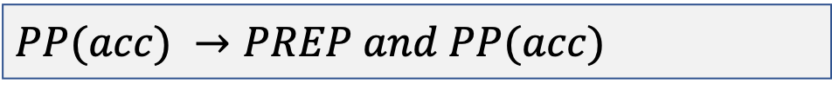

Question 2ii
Incorrect sentences
Him and she went to the park.
$$NP(plu, case) →NP(case) and NP(case)$$
John and Jack drinks coffee.
$$NP(plu, case) →NP(case) and NP(case)$$
John went to the park and drink coffee.
$$VP(case) →VP(case) and VP(case)$$
John went to he.
$$PP(acc) →PREP and PP(acc)$$

Slide 35
Question 2ii
New Grammar Rules
$$S →S and S$$
$$NP(plu, case) →NP(case) and NP(case)$$
$$VP(case) →VP(case) and VP(case)$$
$$PP(case) →PP(case) and PP(case)$$
$$PP(case) →PREP and PP(case)$$
$$ADJP →ADJP and ADJP$$
$$ADVP →ADVP and PP$$

Slide 36
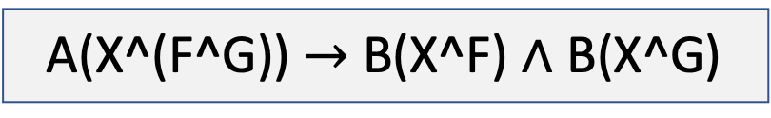
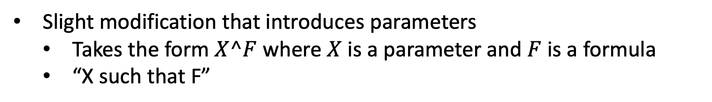
Question 2iii – Logical Form
Slight modification that introduces parameters
Takes the form $X^F$where $X$ is a parameter and $F$ is a formula
“X such that F”
A(X^(F^G)) $→$ B(X^F) $∧$ B(X^G)
Can substitute the parameters for text strings

Slide 37



Question 2iii – Logical Form
$$S(P∧Q) →S(P) and S(Q)$$
John went to the park and Mary went to the beach
$P →$ John went to the park
$Q →$ Mary went to the beach

Slide 38



Question 2iii – Logical Form
$$NP(X^Y^F) →NP(X^F) and NP(Y^F)$$
John and Mary went to the beach
$X →$ John
$Y →$ Mary
$F →$ went to the beach

Slide 39




Question 2iii – Logical Form
$$VP(X^F∧Y^G) →VP(X^F) and VP(Y^G)$$
John went to the park and Mary went to the beach
$X →$ went
$Y →$ went
$F →$ went to the park
$G →$ went to the beach

Slide 40



Question 2iii – Logical Form
$$PP(X^(F∧G))→PP(X^F) and PP(X^G)$$
John went to the park and to the beach
$X →$ to
$F →$ the park
$G →$ the beach

Slide 41



Question 2iii – Logical Form
$$ADJP(X^(F∧G))→ADJP(X^F)and ADJP(X^G)$$
John went to the park and to the beach
$X →$ the
$F →$ park
$G →$ beach

Slide 42




Question 2iii – Logical Form
$$ADVP(X^F∧Y^G→ADVP(X^F)and ADVP(Y^G)$$
John talks quickly and in a loud voice
$X →$ quickly
$F →$ John talks
$Y →$ loud
$G →$ voice

Slide 43


Question 2iv
And
$$A∧B$$
Conjunction that requires both components to be true or apparent.
But
$$A∧¬B$$
Conjunction that requires the first component to be true whilst the second must be false.

Slide 44
Notes
Assignment 2 packages are as follows:
Preprocessing toolkit:
https://www.nltk.org/
Modelling toolkit
https://scikit-learn.org/stable/

